Slide 1

Security Information and event Manager(SIEM) by Azure
Vineeth Mathangi,
B00828528 ,
Mathangi-V@ulster.ac.uk,
MSc Internet of things,
The University of Ulster,
Jordanstown

Slide 2
Table of Content :
Introduction
Existing work
Methodology
Tools implemented
Results
Mapping
Investigation
Prediction
Conclusion
Future work

Slide 3
Introduction :
Organizations and banking websites are currently regarded high-risk, and overall security has become a major worry around the world, as both handle with customers' personal information, guarded accounts, transaction history, and card information.
Authentication and Vulnerabilities are major issues that are understandable problems, yet they represent the most important interaction between security and authentication. Vulnerabilities, on the other hand, can serve as a route for attackers to gain access to sensitive data held by customers.
As a result, using security information and event management (SIEM) and the next generation SIEM (UEBA) User Entity Behavioral Analytics technology, it is possible to detect insider threats , log events perform more sophisticated threat hunting, prevent data exfiltration, and mitigate IoT threats, even when traditional security tools don't raise a single alert..

Slide 4
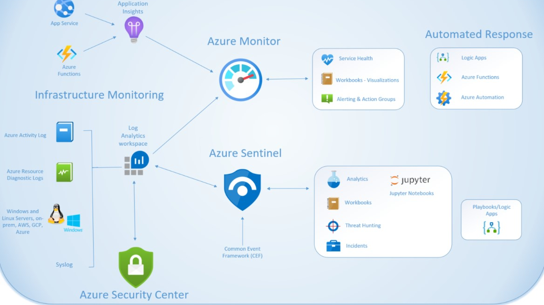
The honeypot (Virtual Machine), a network-attached machine utilized as a proper trap for cyber-attackers to identify and study the tactics, is heavily investigated in this research paper by incorporating the cloud platform Microsoft Azure and developing the honeypot (Virtual Machine). When unsuccessful log events are detected on Azure servers, an alert is triggered by creating a log analytics workspace with the Azure sentinel query. Furthermore, this incident will send an alert to the SOC (security operations Centre) team.

Slide 5
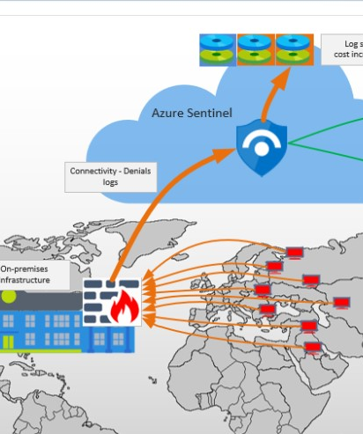
Existing Work
Shortly after it was mounted, a suspicious attack was launched against the organization, resulting in a tremendous number of unexpected log volumes. increased. There have been times when certain users in the azure sentinel has been the target of mysterious attacks . however, dubious methods were implemented. Hackers conduct a broad scan of a huge number of sources. against the customer's public IP addresses, By activating the user firewall, the scan may strike the user firewall. There are a lot of denials in the logs and firewall logs are submitted to the SIEM (Azure Sentinel) has a tremendous impact Intake of logs has increased.

Slide 6
Tools& Technologies Implemented :
Microsoft Azure
Virtual Machine(Honey -pot)
Log Analytics Workspace
Microsoft Cloud defender
Event Viewer
Windows PowerShell ISE
Ipgeolocation (third party API)
Azure Sentinel
Hunting(Tool)
Entity-Behaviour
Jupyter notebook
(ML-Algorithm's)Python

Slide 7
Methodology :
Microsoft Azure is a well-known cloud computing service and a web resources platform that allows users to access and manage cloud services and other technologies
Honeypot (Virtual Machine): This is a technique for catching suspected hackers and uncovering attacks in which intrusion data is made available. Deception, on the other hand, is a practical method and the foundation of honeypots. By supplying protective and misleading ways, these technologies may give attackers the idea that they are fighting a live and actual system.
Event viewer : it records and stores all the system's events. Application, security, setup, system, and forward events are all recorded in the Windows log. We're concentrating on security audit failures, which save failed login attempts in Windows.
Windows PowerShell ISE: Windows PowerShell ISE is a graphical user interface for PowerShell (user interface). ISE (Integrated Scripting Environment), on the other hand, is a graphical user interface for running commands, testing, developing, and debugging scripts without having to type them all in the command line. The API key will run scripts to detect the geolocation (latitude and longitude) of malicious actors all over the world using IP Geolocation (a third party).

Slide 8
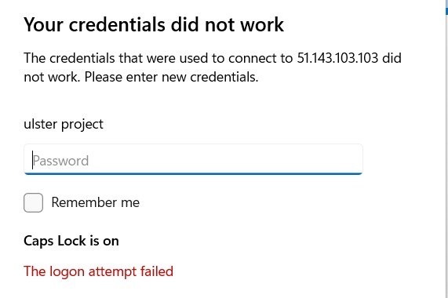
Beginning with the creation of a free trial account in Microsoft Azure, which allows us to use the tools and technology. Virtual Machines, log analytics workspace, Microsoft defender cloud, and Microsoft Sentinel were all utilized during the research procedure. First, make a new virtual machine resource called (Honeypot-lab). Virtual machines are typically used to host programmed and manage the common activities associated with servers. We will also test failed login operations by establishing the Windows OS environment.
Using the same approach, look for log analytics and construct a workspace by configuring all of the VMs' regions and additional features. The next step is to enable Microsoft Cloud Defender, which is used to monitor security posture, harden resources, and defend against cyber-attacks. Defender for the cloud manages their workloads and resources in three ways: defend, secure, and continuously assess. Defender, on the other hand, secures resources by default and assists in pushing logs from the VM to the analytics workspace. Finally, Microsoft Sentinel is a SIEM tool that provides intelligent security analytics and threat intelligence, as well as a single solution for attack detection, threat visibility, proactive hunting, and entity behaviors.
I created a project account and a real random password , however I entered the erroneous username, 'ulster,' for testing audit failure purposes. It creates an audit failure in the security events almost instantaneously. The logon attempt that failed is depicted in the figure .
As a result, the credentials we used for the testbed worked. After that, by logging in with appropriate authentication, you can control a remote desktop.

Slide 9
A further step is open Event viewer helps scan the text log files and aggregate them, and it acts as a database reporting programmer. However, our aim to analyze the security events, also called 'audits’. ISE collects all the audit failure information to the security events then all the collected live data is split into a text file called "Failed_RDP .
“ latitude:54.61002, longitude: -5.90277, destination host: honeypot-vm , username :ulster ,sourcehost:51.143.103.103,state:Northern Ireland, country: United Kingdom , timestamp:2022-04-25 14:40:33 “.
Well, from analytics workspace created a custom log to select the collection of paths which pushes all the captured data from the virtual machine(honeypot) to the log analytics workspace.

Slide 10
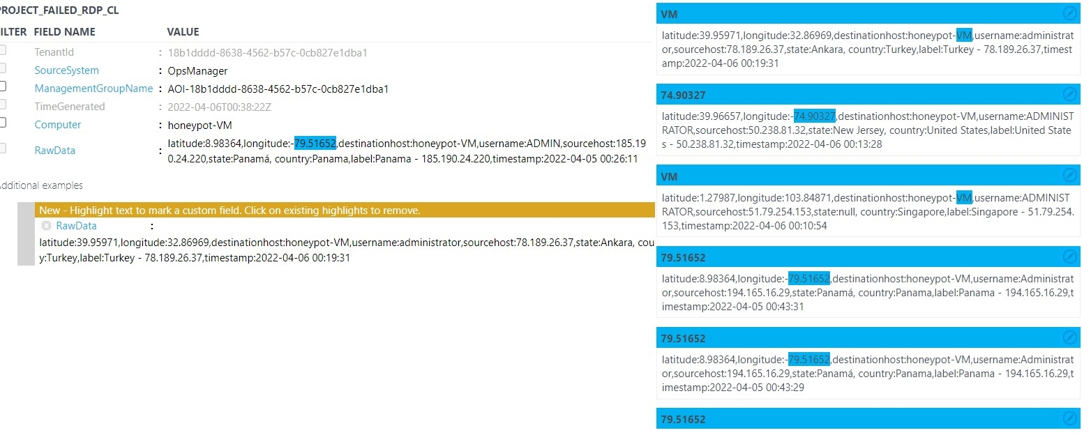
the extraction of longitude by verifying the data whether all belong to longitude or not. And if any extracts initially are not correct, then need to rectify and edit by using the modification column.

Slide 11
Only collected data following field extraction is accepted in the Custom field, as long as records fulfil the stated criteria and are added to the Analytics workspace. Only live log data can be monitored or saved after fields have been extracted. Sentinel has conducted a thorough examination of hunting, in which it uses queries to proactively identify the behaviors of risks and entities and geolocation of all the failed RDP.
Firstly, I decided to detect the suspicious attacker's geolocation to check whether it is an insider or external threat. Considering my testbed, which comes under insider, means through from inside user of an organization need to access the sensitive information of a particular company.

Slide 12
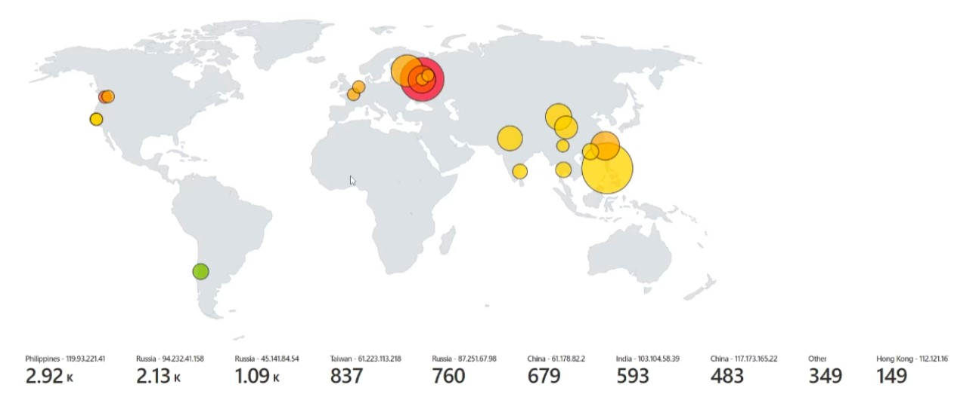
Results :
Data has directly driven into Sentinel mapping visualization and allows all the coordinates of the attackers all over the world. So, they are easily detectable. Overall, 2 hours of live attacks mapping tells each event occurs in a different location with different IP addresses . Russia is with the greater number of log events, approximately 5k, in that monitored with three different Ip addresses such as 2.13k(events) - 94.232.41.158(IP), 1.09k (Events)– 45.141.84.54(IP), and 760(Events) – 87.251.67.98(IP).

Slide 13
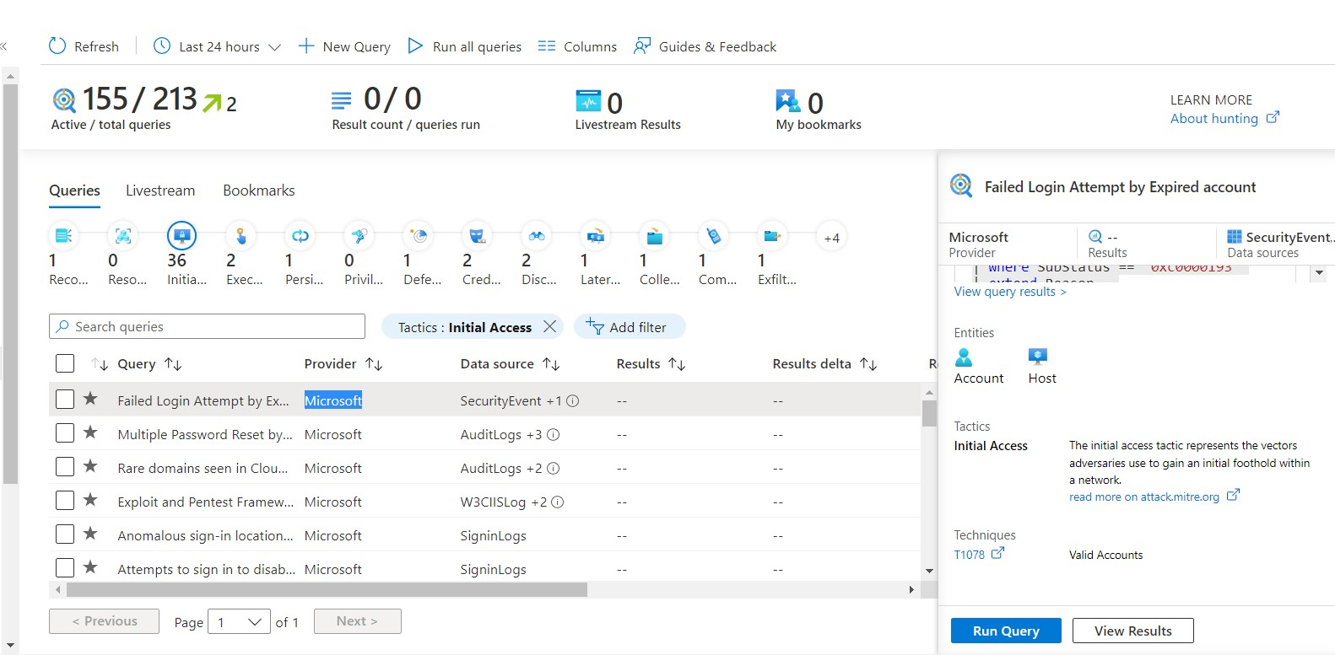
Hunting :
Hunting is a powerful tool for security threats that protect the organization. it helps us find out the threat actor’s move so that defenders can protect their organization as a wall.

Slide 14
From all the events, only 155 are active queries out of 213 queries. The initial access tactics refer to the various entry of vectors used to gain control over a network. After running an inbuilt query, entities are Account and Host, which means attackers are trying to gain access from a random account as a valid account through a virtual machine.
The T1078 (Valid accounts) technique says that adversaries from existing accounts attackers may obtain and use credentials to gain initial access or Defense Evasion.
. Hunting proves that the credentials which the attackers use may no longer be part of a particular organization, and by using these authentications, they pretend to be the original account of the user.

Slide 15
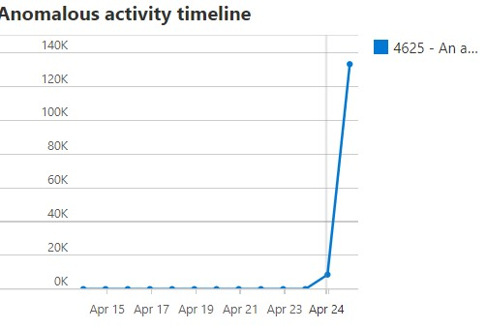
Anomalous Activity : By this activity , we can say that 4625 – log off events takes place with the highest number of entries anomaly score is around 176.55.

Slide 16
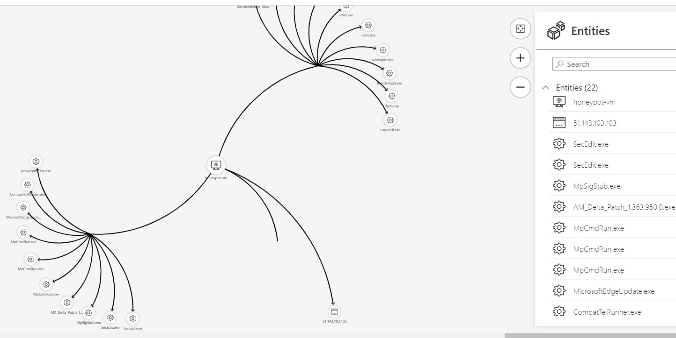
Investigation: An incident is entirely predicated on an analytics rule set in the workspace for a particular investigation pace. Sentinel aids in the detection of suspicious conduct and threats.As per the method entity graph of investigation, several entities take place, such as host (51.143.103.103) and process execution events tracer. Let’s discuss tracelog.exe (trace logs). These logs produce an event; each contains trace messages during the sessions. Overall, the investigation graph helps to understand the scope of the threat and the cause by correlating the relevant data with any other involved entities.

Slide 17
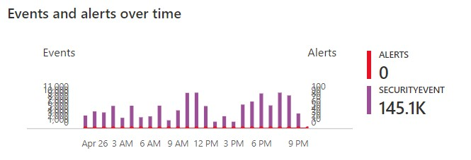
Security Events & Alerts: The captured security events are around 145.1k in 24 hours of live events.
Alert description: Although none of them succeeded, some of them used accounts recognized by the host. it resembles a dictionary attack, in which an attacker performs numerous authentication attempts using a dictionary of predefined account names and passwords to find valid credentials to access the host. it indicates that some of your host account names might exist in a well-known account name dictionary.

Slide 18
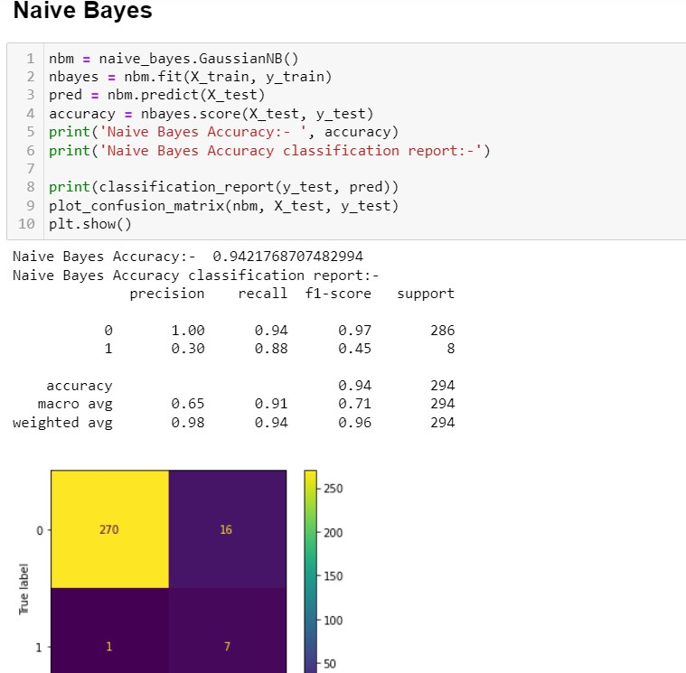
Prediction :Generally, classification plays a key role in retrieved data. The most commonly used classifications are KNN (k-nearest neighbors), (Naïve Bayes), NB, .above all, KNN is one of the best and most effective classification algorithms in the vector space model.
I used Nave Bayes) for training and testing our prediction comparative analysis. after training the model accuracy obtained as 94 percent .

Slide 19
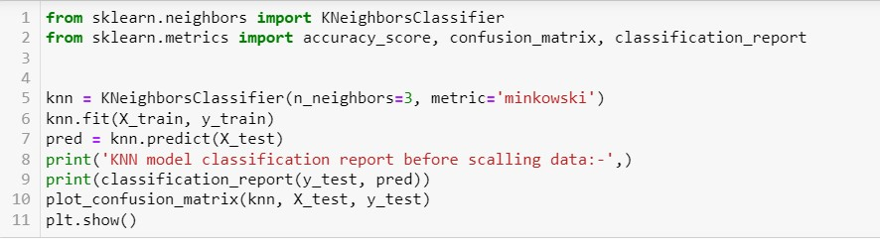
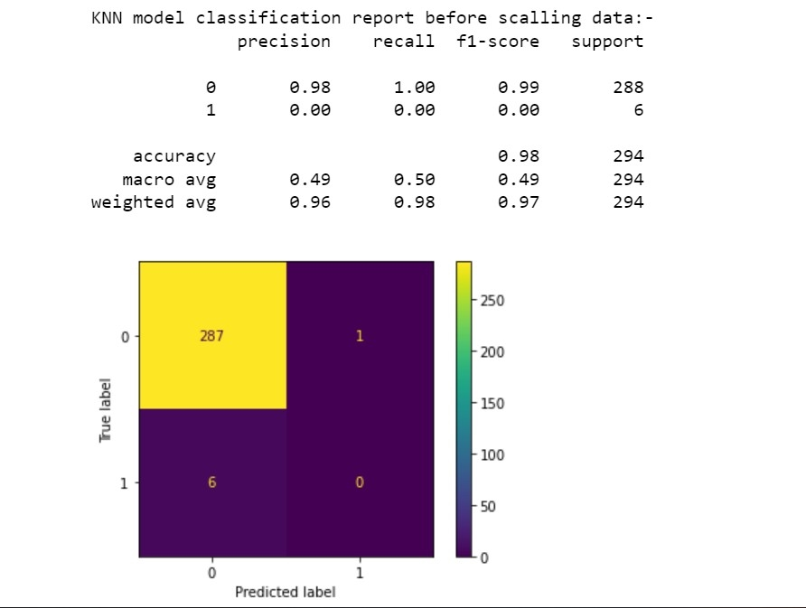
The scaling data report's classification visualizes the display of the model's precision, recall, F-1, and support scores of . The overall accuracy 98 of the KNN model prediction was correct between a true label and a predicted label. Support is said to be an actual number of occurrences in the specific dataset; it just diagnoses the evaluation process.

Slide 20
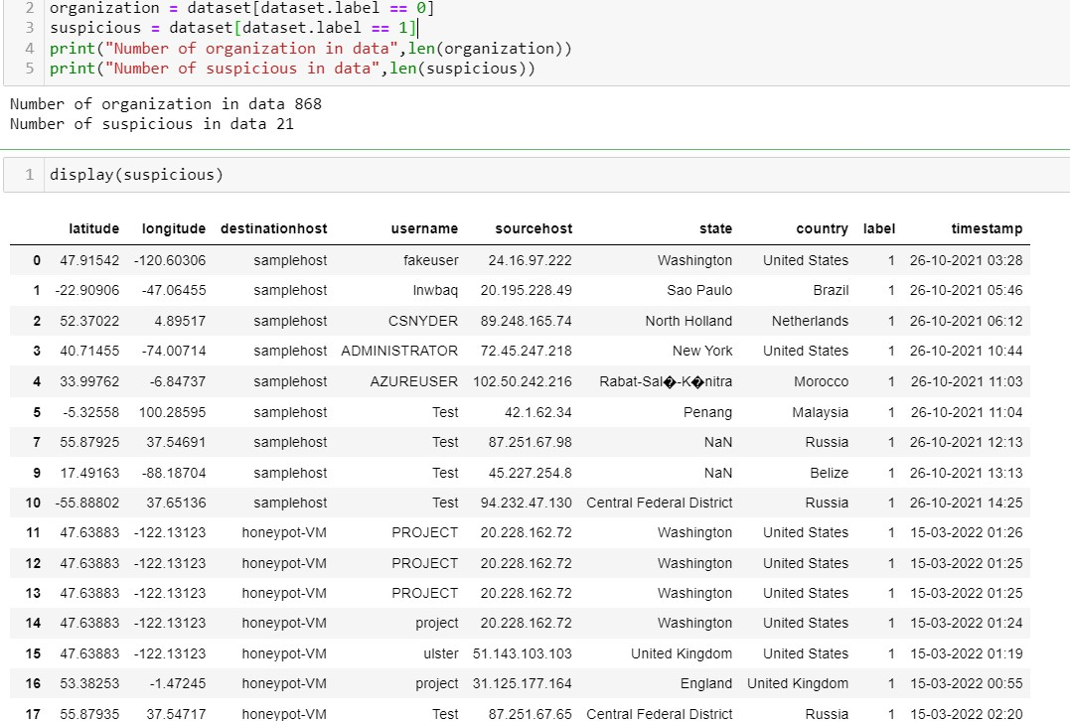
Overall, by train and test and testbed results, the final mark considered as 21 might be attackers out of 900 users. On the other hand, in 21, I’m one of the suspected attackers who tried to step inside the organization.

Slide 21
Conclusion :
A summary, we have tried all the possibilities of detecting the adversary's geolocation and their sort of attacks, analyzing and investigating these brute force RDP attacks to protect the companies from future pre-attacks. However, it is also crucial to remind that log events are employed in various settings. Their incident response is technically high; well, most log usage occurs more often. So, for innovation and uniqueness of the project, I have made a testbed that truly acts as an attacker. I have taken the initiative and create a honeypot (Virtual machine) and try to log in with a fake credential. Once the event occurred and recorded in an event viewer, can ingest it to the analytics workspace. After ingesting the raw data, it can be extracted to the sentinel and captures all the live attacks or threats to the organization. After collecting and calculating all the failed events, which is "4625-failed log on, "has collected numerous hosts from different countries, which decides the majority of the attackers rather than genuine users. I have made my samples into three different sections to predict and protect from bad resources by analyzing all the situations.
I decided to detect the suspicious attacker's geolocation to check whether it is an insider or external threat. Considering my testbed, which comes under insider, means through from inside user of an organization need to access the sensitive information of a particular company. Secondly, I swapped my place from the hacker to the defender, to protect against all the threats and vulnerabilities. Took part started all the investigation like a hunter with hunting the initial access, after running the query tactics justifies those adversaries are tried to foothold within a network. Moreover, Accounts and Host are the entities involved in our investigation; T1078 is the technique for valid accounts used by attackers to mitigate the threats, enforce to use the of strong passwords, and do not re-use them across multiple resources and services.

Slide 22
As per our comparative prediction analysis, I tried Naïve Bayes, SVM (Support Vector Machine), and KNN (K-nearest neighbor’s). From all the above, KNN is considered the best method for precision. Hence it gives an accuracy of 98 percent. However, Naïve Bayes is 94, as well as SVM, is 96 percent. Overall, by train and test and testbed results, the final mark considered as 21 might be attackers out of 900 users. On the other hand, in 21, I’m one of the suspected attackers who tried to step inside the organization.
Future attacks prevention : In short, some active security recommendations prevent future attacks. Firstly, the machines should encrypt temp disks, caches, and data between storage resources and computing. Secondly, should restrict all the network ports to a specific network security group. Lastly, all the internal machines should have a vulnerability assessment solution.
Extended work :This investigation has chances of extending for more clearance of work. Many business organizations use the (TIP) Threat Intelligence platform solutions . are used to accumulate the threat and vulnerability feeds from different sources within the sentinel platform. one of the best security solutions is EDR (End point Detection and Response)/XDR (Extended Detection and Response). XDR uses high-end security techniques that it collects and correlates the data from servers, endpoints, cloud workloads, and logs. Moreover, XDR enhances with SecOps efficiency, improving detection, etc. Sentinel ones is an XDR AI platform that benefits from a single solution with single code based and deployment model.

Slide 23
Thank You
Vineeth Mathangi (B00828528).

